Slide 1
M365 OneDrive Migration Solution Accelerator Customer Presentation
<Insert Name Here>
<Insert Date >

Slide 2
M365 OneDrive Migration Solution Accelerator Agenda
Migrating Data
Tendencies
Missed Opportunities
Solution Accelerator Overview
When to use Azure Data Box?
Solution Workflow
Keys for a Successful Migration
M365 OneDrive Migration Solution Accelerator Requirements
Technical Requirements for Implementing the Solution Accelerator
Q & A
Questions and Answers

Slide 3
Natural Reaction to the Migration of Data and Benefits

Slide 4
What do we naturally want to do when migrating data Tackling the hard problem
Tendencies
Focus on what we know or what we see as the challenge
We focus on the technical aspects because it is tangible
We see the hurdles, shared experiences
We assess that moving of data is the challenge
Missed Opportunities
The data movement becomes the path to using M365 and we miss what else could be done
We build a disconnect between the expectation and the action needed
We funnel adopting M365 OneDrive through the hardest steps first
Starting earlier

Slide 5

Benefits of Migrating to M365 OneDrive
Increase collaboration, discoverability and compliance across your organization
You already have an M365 subscription and wish to drive adoption
Your users need a modern, easy organization-approved way to store, manage and share files
Notes:
Why should users move their files to OneDrive for Business in Office 365?
OneDrive for Business is the SharePoint Server 2013 personal library that people in your organization use to store and share their corporate work documents. By moving these documents to OneDrive for Business in an Office 365 tenant, your users can access these documents from outside of your network.
After you connect your SharePoint Server 2013 on-premises users to OneDrive for Business in Office 365, the first step is planning how your users will move their files to the cloud. This article describes methods that you can use to do this.

Slide 6
M365 OneDrive Migration Solution Accelerator Overview

Slide 7
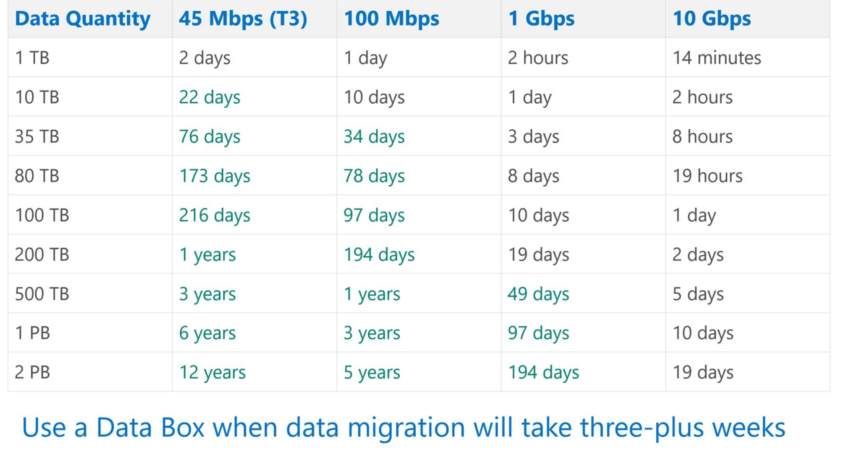
When to Use a Data Box?

Slide 8
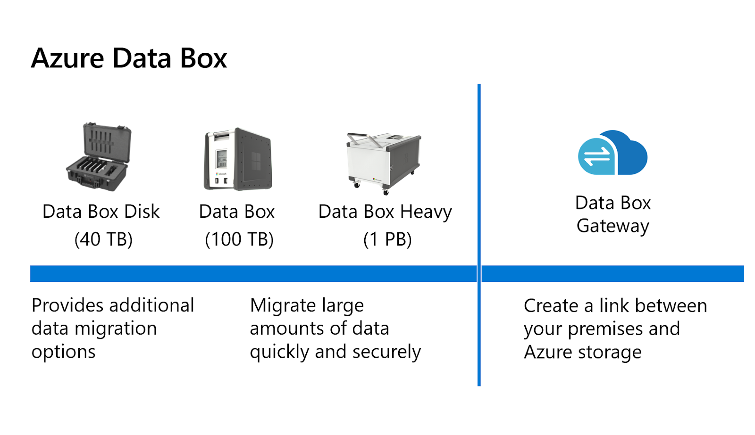
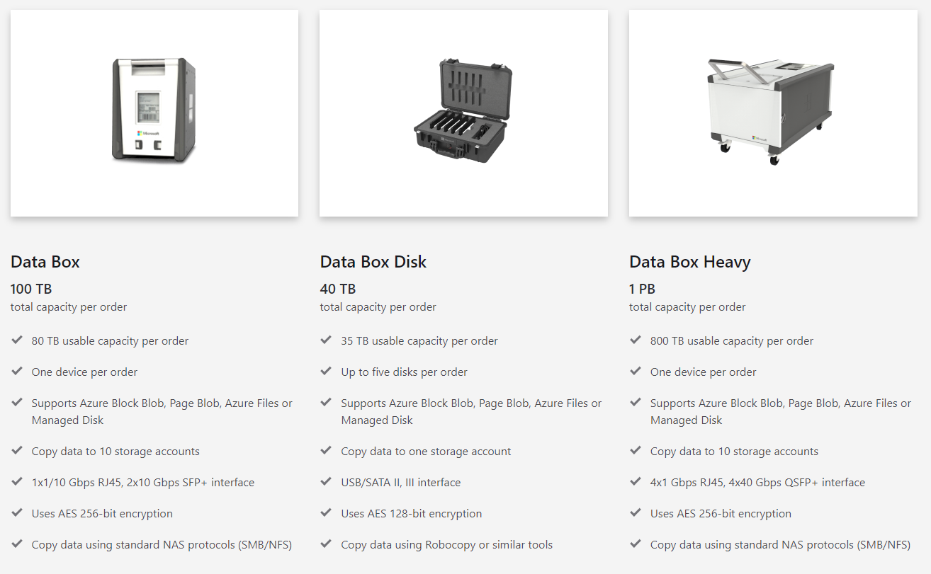
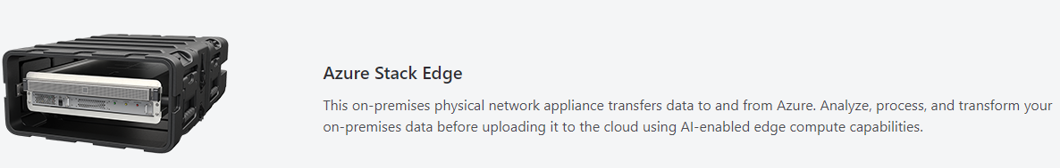

Data Box Family

Slide 9
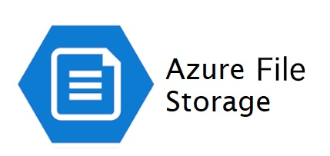
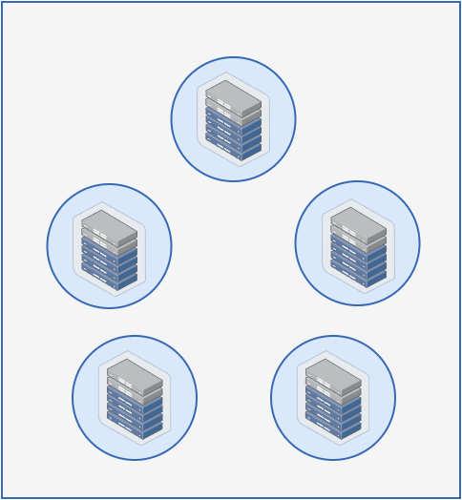
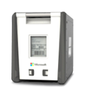
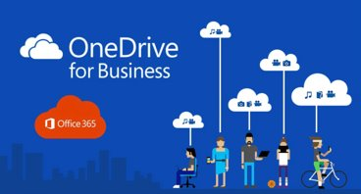
Azure Migration Factory for M365 OneDrive
A solution accelerator enabling customers to accelerate their migration on-premises to a SaaS cloud-based solution
On-Premises Data (OneDrive/SharePoint)
Azure Data Box
Data Centers
Data Center 1
Data Center 3
Data Center 2
Azure File Storage hosted within the Azure Migration Factory
Data Center 4
Data Center 5
High Level Dataflow

Slide 10
Keys for a Successful Migration
Inventory and rationalize your data before you begin a migration project
Partner early with Executive Leadership, Data Owners, Security, and the business segment from your organization
Prune data that can be archived directly to “cool” tier rather to active data teirs if possible
Ensure that the on-premises datacenter environment has the infrastructure to facilitate a migration
Avoid conducting multiple migrations projects at the same time which have interdependencies

Slide 11
M365 OneDrive Migration Solution Accelerator Requirements

Slide 12
Solution Accelerator Requirements
Access to a valid Azure Subscription
Proper administrative access to the Azure subscription. Recommended subscription owner or contributor
A valid network range to assign to the Azure virtual network
The internal IP address of a Virtual Appliance (Azure Firewall) deployed inside the Hub virtual network to route administrative traffic back to on-premises if required
The ability to peer the migration virtual network to a Hub virtual network if required, create a VPN, or connect the solution to an Azure ExpressRoute
Access to Visual Studio Code or Notepad ++ with Azure Resource Manager support. Visual Studio Code can be downloaded from here: Visual Studio Code - Code Editing. Redefined
Notepad ++ is part of the Windows Store on Windows 10
Depending on scenario and amount of data being transferred choose the right device. Review the following:
Microsoft Azure Data Box Disk system requirements | Microsoft Docs
Microsoft Azure Data Box system requirements | Microsoft Docs
Download Data Box Disk toolset for Windows if required
Proper access to the source data with administrative access
Please review Migrate your files to Microsoft 365 with Migration Manager - Migrate to Microsoft 365 | Microsoft Docs

Slide 13
Q & A

Slide 14

Join the Microsoft Tech Community to collaborate, share, and learn from the experts: http://techcommunity.microsoft.com

Slide 15
Thank you

